Slide 1
Abstraction in Java

Slide 2
What is Abstraction?
Abstraction means hiding internal implementation details and showing only essential features to the user.
Simple meaning:
Show what the object does
Hide how it does it

Slide 3
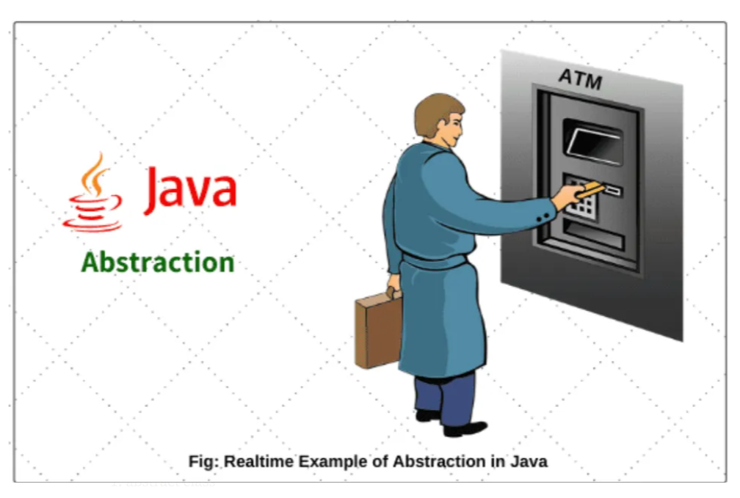
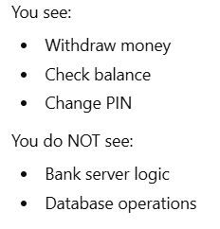
For example, ATM machine , we don’t need to know how ATM machine works , only need to know where we insert card and where we can take money. Let’s start to understand in term of programming langauge.

Slide 4
Why Abstraction is Important?
Simplifies Complexity: It allows developers to create models of real-world systems that are easier to understand and work with.
Modularity: Abstraction promotes modularity by breaking down a system into smaller, reusable components.
Security: It helps protect sensitive data and implementation details by hiding them from users who don’t need to know about them.
Maintainability: Abstraction makes it easier to update and maintain code since changes to one part of an abstracted system don’t necessarily affect other parts.

Slide 5
How Abstraction is Achieved in Java?
In Java , Abstraction can be achieved by two ways .
abstract class
Interface
Method | Keyword Used
Abstract Class | abstract
Interface | interface

Slide 6
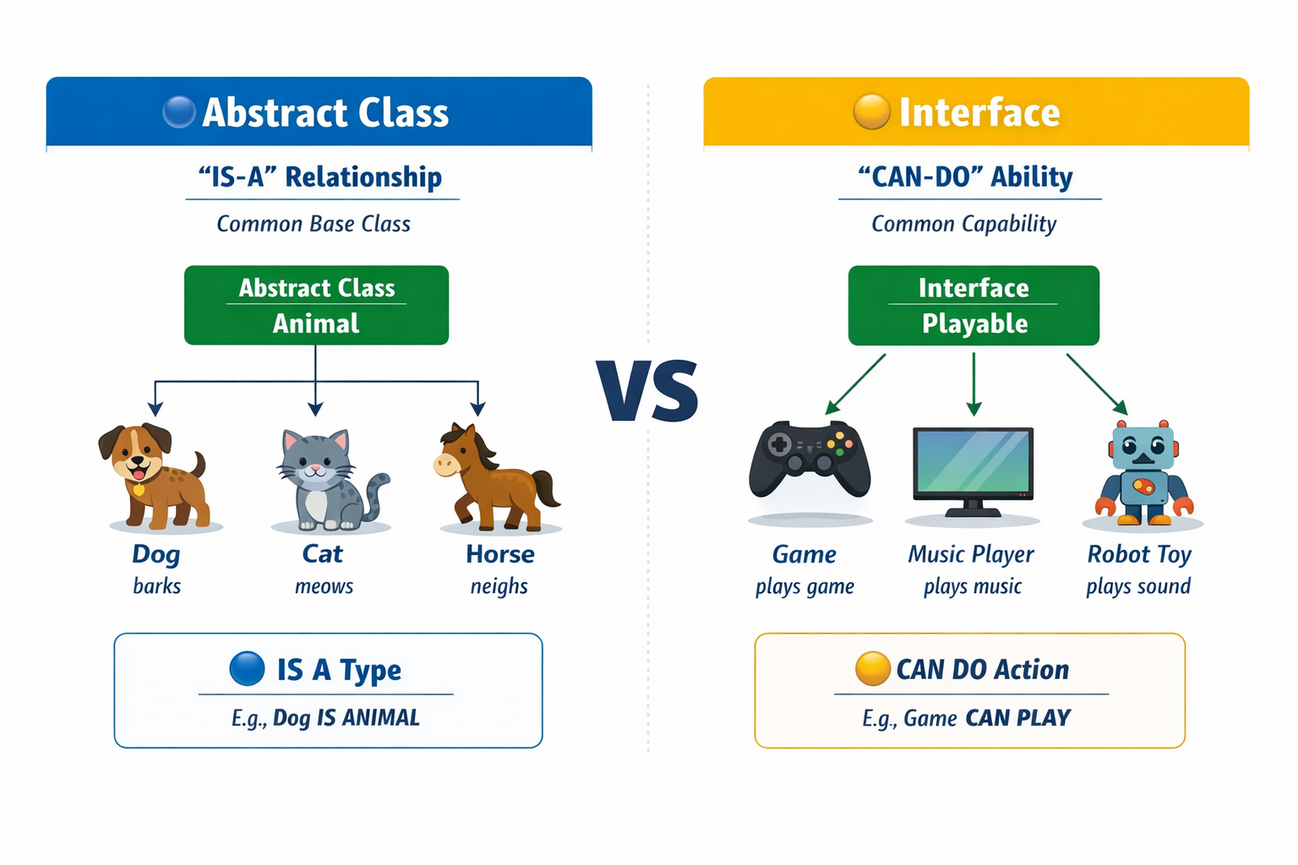
Difference
Dog, Cat, and Horse are all closely related. They are all types of Animal. So we use Abstract Class.

Slide 7
Example
class Dog extends Animal {
void sound() {
System.out.println("Dog barks");
}
}
class Cat extends Animal {
void sound() {
System.out.println("Cat meows");
}
}
class Horse extends Animal {
void sound() {
System.out.println("Horse neighs");
}
}
abstract class Animal {
abstract void sound(); // common rule
}

Slide 8
Interface
Diagram shows:
Game, Music Player, Robot Toy → all connected to Playable
Game is not a Music Player Music Player is not a Robot They are unrelated things But all of them can do one common action: They can “PLAY”

Slide 9
So we create an interface:
Now different unrelated objects implement it:
interface Playable {
void play();
}
class Game implements Playable {
public void play() {
System.out.println("Game is playing");
}
}
class MusicPlayer implements Playable {
public void play() {
System.out.println("Music is playing");
}
}
class RobotToy implements Playable {
public void play() {
System.out.println("Robot is playing sound");
}
}

Slide 10
abstract class Animal {
abstract void sound();
}
interface Playable {
void play();
}
class Dog extends Animal implements Playable {
void sound() {
System.out.println("Dog barks");
}
public void play() {
System.out.println("Dog plays with ball");
}
}
Dog IS an Animal → abstract class
Dog CAN PLAY → interface
This shows real-world design clearly
Abstract Class → IS-A (family relationship) Interface → CAN-DO (skill / ability)

Slide 11
Question???
Laptop, Mobile, Tablet → all can connect to WiFi
What should we use? Interface (because they are unrelated but share ability)

Slide 12
Normal Class (No abstraction)
class Animal {
void sound() {
System.out.println("Some sound");
}
}
Animal a = new Animal();
a.sound();
❌ What is "Some sound"? Animal itself does not have a clear sound. This is bad design.

Slide 13
Abstract Class (With abstraction)
abstract class Animal {
abstract void sound(); // no body
}
Now this is better design because:
Animal itself does not have sound
Only Dog, Cat, Horse should define sound
So we force child classes to define it
class Dog extends Animal {
void sound() {
System.out.println("Dog barks");
}
}

Slide 14
Abstraction Using Abstract Class
A class which is declared as abstract is known as an abstract class.
Is declared using abstract keyword
Can have:
Abstract methods (no body)
Concrete methods (with body)Cannot create object directly
Syntax abstract class ClassName
{ abstract void methodName(); }

Slide 15
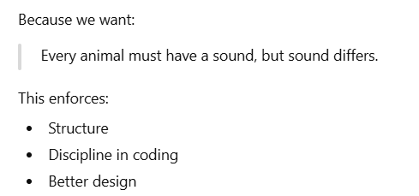
Abstract Class Example
abstract class Animal {
abstract void sound();
}
class Dog extends Animal {
void sound() {
System.out.println("Dog barks");
}
}
Animal defines rule
Dog provides implementation

Slide 16
Interface
An interface is:
A fully abstract blueprint
Uses keyword interface
Supports multiple inheritance
interface Vehicle {
void start();
}

Slide 17
interface Vehicle {
void start();
}
class Bike implements Vehicle {
public void start() {
System.out.println("Bike starts with kick");
}
}
Explanation:
Interface defines rule
Class follows rule

Slide 18
Real-Time Use of Interface
Example: Payment System
Interface: Payment
Classes:
GooglePay
PhonePe
CreditCard
All must implement:
void pay();
Used in:
E-commerce apps
Banking software
Android development

Slide 19
abstract class Animal {
// Constructor
Animal() {
System.out.println("Animal constructor called");
}
// Abstract method (no body)
abstract void sound();
// Normal method (with body)
void sleep() {
System.out.println("Animal is sleeping");
}
}
class Dog extends Animal {
// Implementing abstract method
void sound() {
System.out.println("Dog barks");
}
}
public class Main {
public static void main(String[] args) {
// Animal a = new Animal(); Not allowed
Animal a = new Dog(); // Allowed (abstract class reference)
a.sound(); // Calls Dog's method
a.sleep(); // Calls Animal's method
}
}

Slide 20
Abstract Class – Key Points
Feature | Abstract Class
Keyword used | abstract
Object creation | Not allowed
Can be extended | Yes
Purpose | Acts as blueprint for child classes
Can have abstract methods | Yes
Can have normal methods | Yes
Forces child to override methods | Yes
Can have constructor | Yes
Can have main method | Yes
Can have static methods | Yes
Can have final methods | Yes
Relationship used | IS-A relationship
Best used when | Classes are closely related
Example | Dog is an Animal

Slide 21
Normal Class vs Abstract Class
Feature | Normal Class | Abstract Class
Object creation | Allowed | Not allowed
Abstract methods | Not allowed | Allowed
Method body | All methods must have body | Can have methods without body
Must be extended | No | Yes, to be used
Forces method implementation | No | Yes
Design purpose | General use | Blueprint / rule definition
Example | Car class | Vehicle class

Slide 22
Abstract Class vs Interface
Feature | Abstract Class | Interface
Keyword | abstract | interface
Object creation | Not allowed | Not allowed
Inheritance | Supports single inheritance | Supports multiple inheritance
Methods | Abstract + Normal methods | Abstract methods (default/static allowed in Java 8+)
Constructor | Allowed | Not allowed
Variables | Can be any type | Always public static final
Relationship | IS-A (closely related classes) | CAN-DO (ability of unrelated classes)
Example | Dog is an Animal | Dog can be Runnable, Playable

